Slide 1
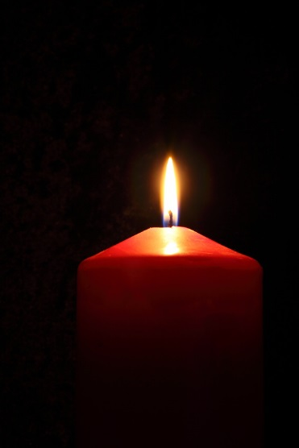
Man’s Search for Meaning: an Existential View in Horror
Kevin James Leugers

Slide 2
Viktor E. Frankl
Austrian neurologist and psychologist
Survivor of the Holocaust (Choice)
Creator of Logotherapy
Man’s Search for Meaning, relates his experiences at the death camps

Slide 3
Existentialism
Jean-Paul Sartre
Defied perceptions of humans as sentient beings
Actions and decisions cannot be broken down to a science
Third World.
“The Existential Attitude” and Man’s Search
Frankl’s Proposition:
Notes:
Defied earlier perceptions of humans as sentient beings or pleasure-driven creatures.
Human actions and decisions cannot be broken down to a science by psychology or biology.

Slide 4
A man with nothing
Begins his work with a tale from Arthur Miller’s Incident at Vichy.
We are never left with nothing.
Self-esteem and values are misplaced.
We are too caught up in this world that our self worth and who we are as people are defined by accomplishments and titles rather than understanding that “one’s inner value is anchored in higher, more spiritual things, and cannot be shaken by camp life.” (63)

Slide 5
Suffering
Survival required feigning life.
Beatings: “Unreasonableness of it all.” (32)
“Man can adjust to anything, just don’t ask us how.” (18)
Numbers and Sheep
Hopelessness
Conclusion: There is no logical reason to continue to live.

Slide 6
Choice and Inner Strength
They chose to have hope.
“We who lived, in concentration camps can remember the men who walked through the huts comforting others, giving away their last piece of bread. They may have been few in number, but they offer sufficient proof that everything can be taken from a man but one thing: the last of the human freedoms — to choose one’s attitude in any given set of circumstances, to choose one’s own way.” (66)

Slide 7
Redefining Suffering
Meeting
“If there is meaning in life at all, then there must be meaning in suffering.” (89)
There must be value in choosing to sacrifice for a cause or idea.
Meaning to Suffering
Endure pain for a purpose.
Some chose to walk to the gas chambers with their chins held high.

Slide 8
Meanings in Life
Viktor Frankl believed that purpose is created through three passions:
Love
“The angels are lost in perpetual contemplation of an infinite glory.”
Work
We live for the future.
Sacrifice
Choosing to suffer pain

Slide 9
Where do you find meaning?

Slide 10
QUESTIONS?
Want to change your life? Read.
WHY do we act the way we do? (e.g. awkward, want/desire certain things)

Slide 11
Credits
Man’s Search for Meaning
Stanford Encyclopedia of Philosophy

